Slide 1

Efficientdat: scalable and efficient object detection
Mohamed Abdo Elnashar

Slide 2
There are three major contributions
BiFPN
Compound scaling
EfficientDet

Slide 3

There are three major contributions

Slide 4

Bifpn
A weighted bidirectional feature network for easy and fast multi-scale feature fusion.
The idea of FPN
This Photo by Unknown Author is licensed under CC BY

Slide 5
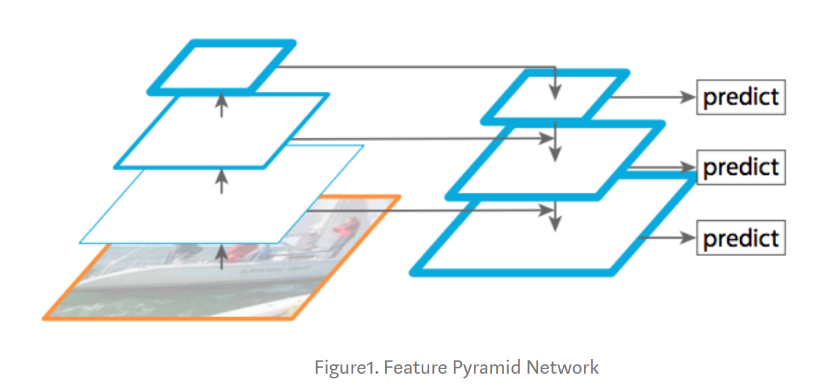
FPN ( Feature Pyramid Network )

Slide 6
FPN ( Feature Pyramid Network )
is a feature extractor designed for such pyramid concept with accuracy and speed in mind.
It replaces the feature extractor of detectors like Faster R-CNN and
generates multiple feature map layers (multi-scale feature maps).
FPNs achieves this by combing bottom-up pathway with top-down pathway using lateral connections.

Slide 7
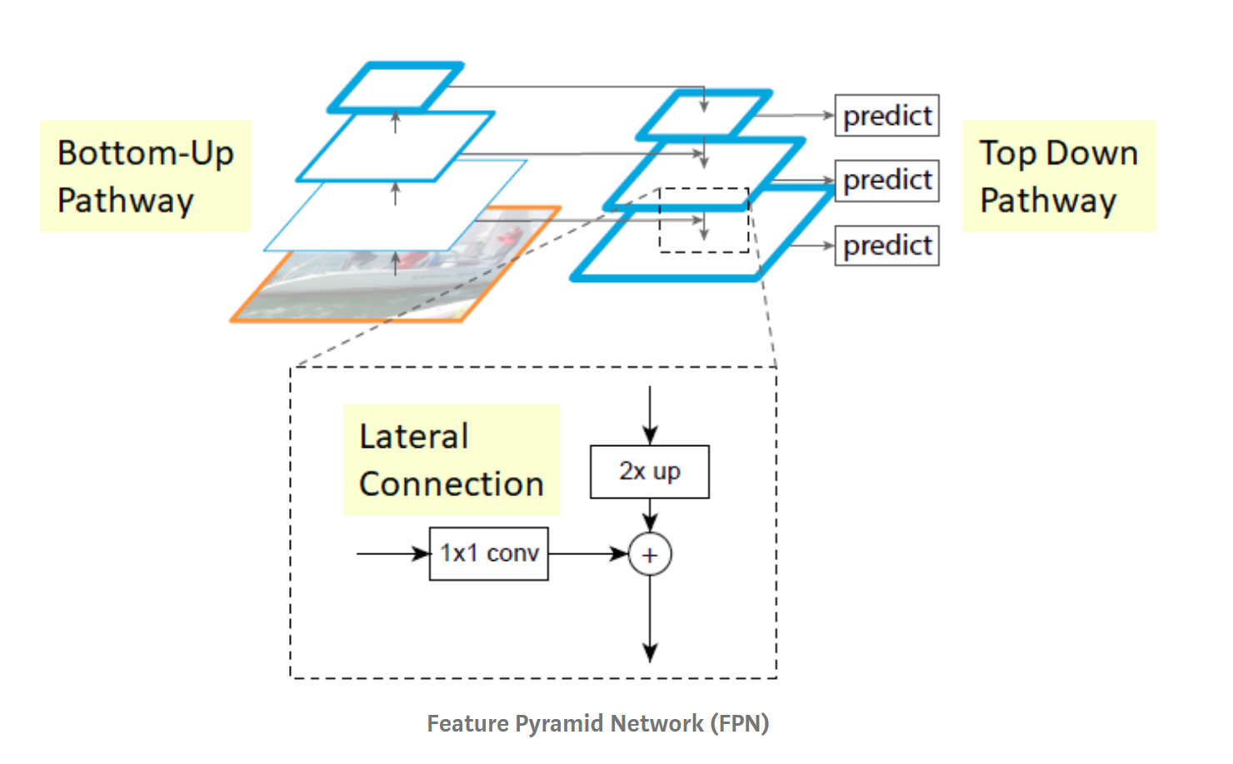
FPN ( Feature Pyramid Network )

Slide 8
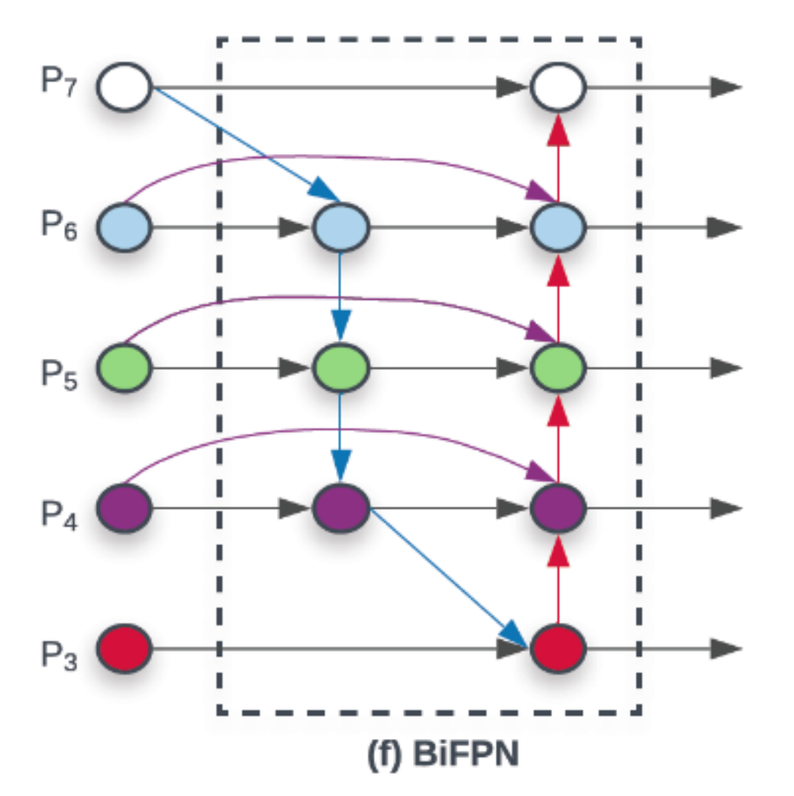
BIFPN (BIdirectional Feature Pyramid Network )
1- Remove the nodes that only have one input edge
2- Add an extra edge from the original input to output node
3- The authors treat each bidirectional (top-down & bottom-up) path as one feature network layer, and repeat the same layer multiple times to enable more high-level feature fusion. The result of these optimizations is the new feature network named as BiFPN

Slide 9

There are three major contributions

Slide 10
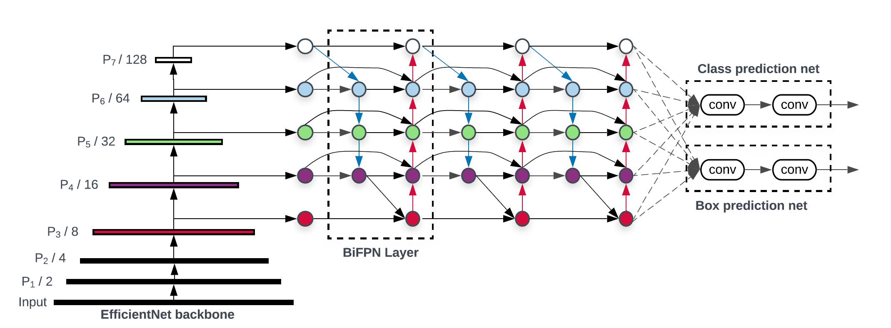
EfficientDet
As the name suggests, using EfficientNets as the backbone network along with BiFPNs, we get a new family of detectors called EfficientDet.

Slide 11
EfficientDet (Architecture)
1- EfficientDet detectors are single-shot detectors much like SSD and RetinaNet.
2- The backbone networks are ImageNet pretrained EfficientNets.
3- The proposed BiFPN serves as the feature network, which takes level 3–7 features {P3, P4, P5, P6, P7} from the backbone network and repeatedly applies top-down and bottom-up bidirectional feature fusion.
4- These fused features are fed to a class and box network to produce object class and bounding box predictions respectively
5- The class and box network weights are shared across all levels of features.

Slide 12

There are three major contributions

Slide 13
Compound Scaling
A new method, which jointly scales up backbone, feature network, box/class network, and resolution, in a principled way.
Object detectors have much more scaling dimensions than image classification models, so grid search for all dimensions is very expensive. Therefore, the authors used a heuristic-based scaling approach, but still, follow the main idea of jointly scaling up all dimensions.

Slide 14
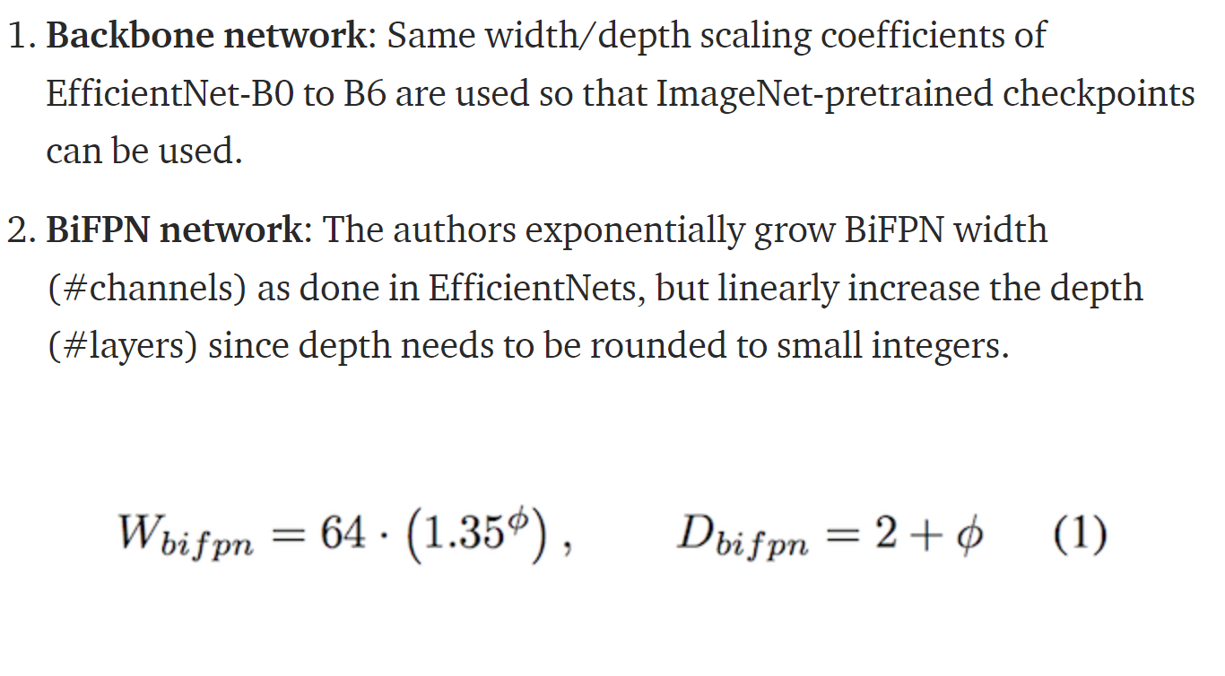
The main idea of jointly scaling up all dimensions

Slide 15
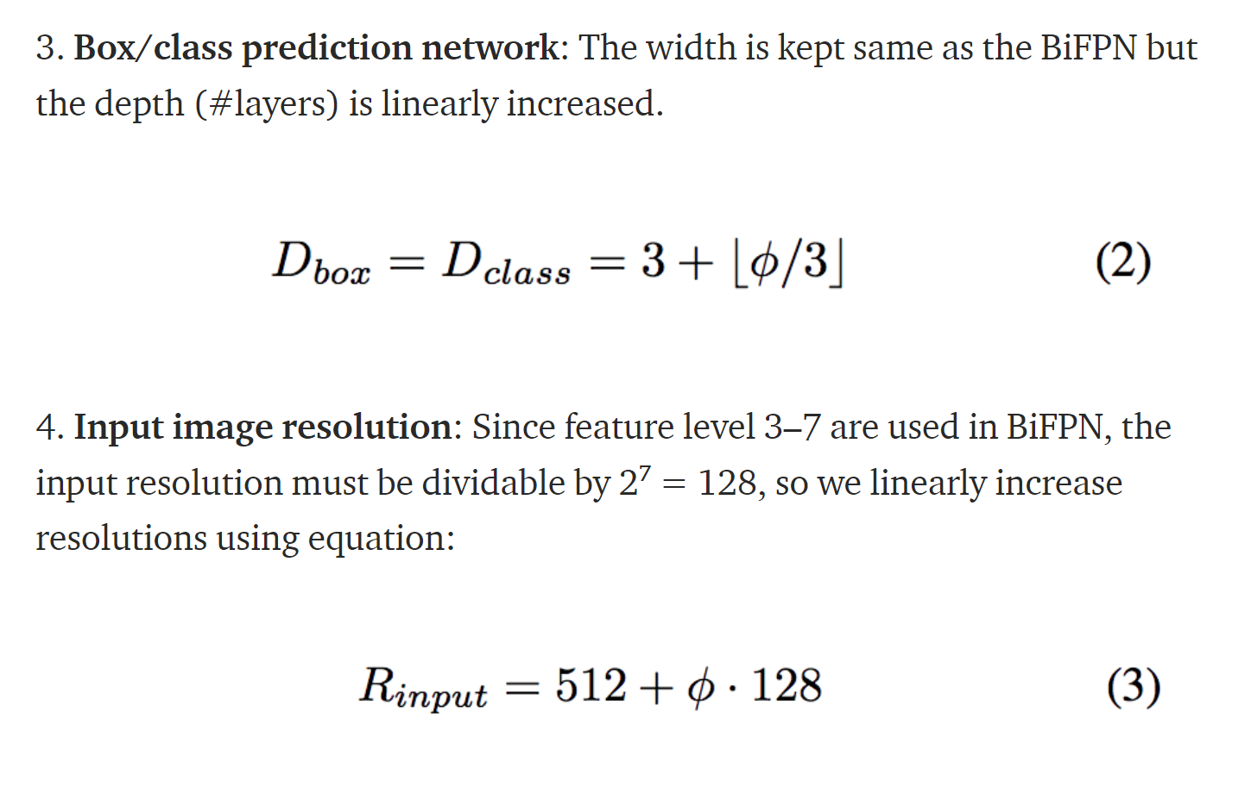
The main idea of jointly scaling up all dimensions

Slide 16
The main idea of jointly scaling up all dimensions
Now, using equations (1), (2), and (3),
and different values of ϕ ,
we can go from Efficient-D0 (ϕ=0) to Efficient-D6 (ϕ=6).
models scaled up with ϕ ≥ 7 could not fit memory unless changing batch size or other settings.
Therefore, the authors expanded D6 to D7 by only enlarging input size while keeping all other dimensions the same, such that we can use the same training settings for all models. Here is a table summarizing all these configs

Slide 17
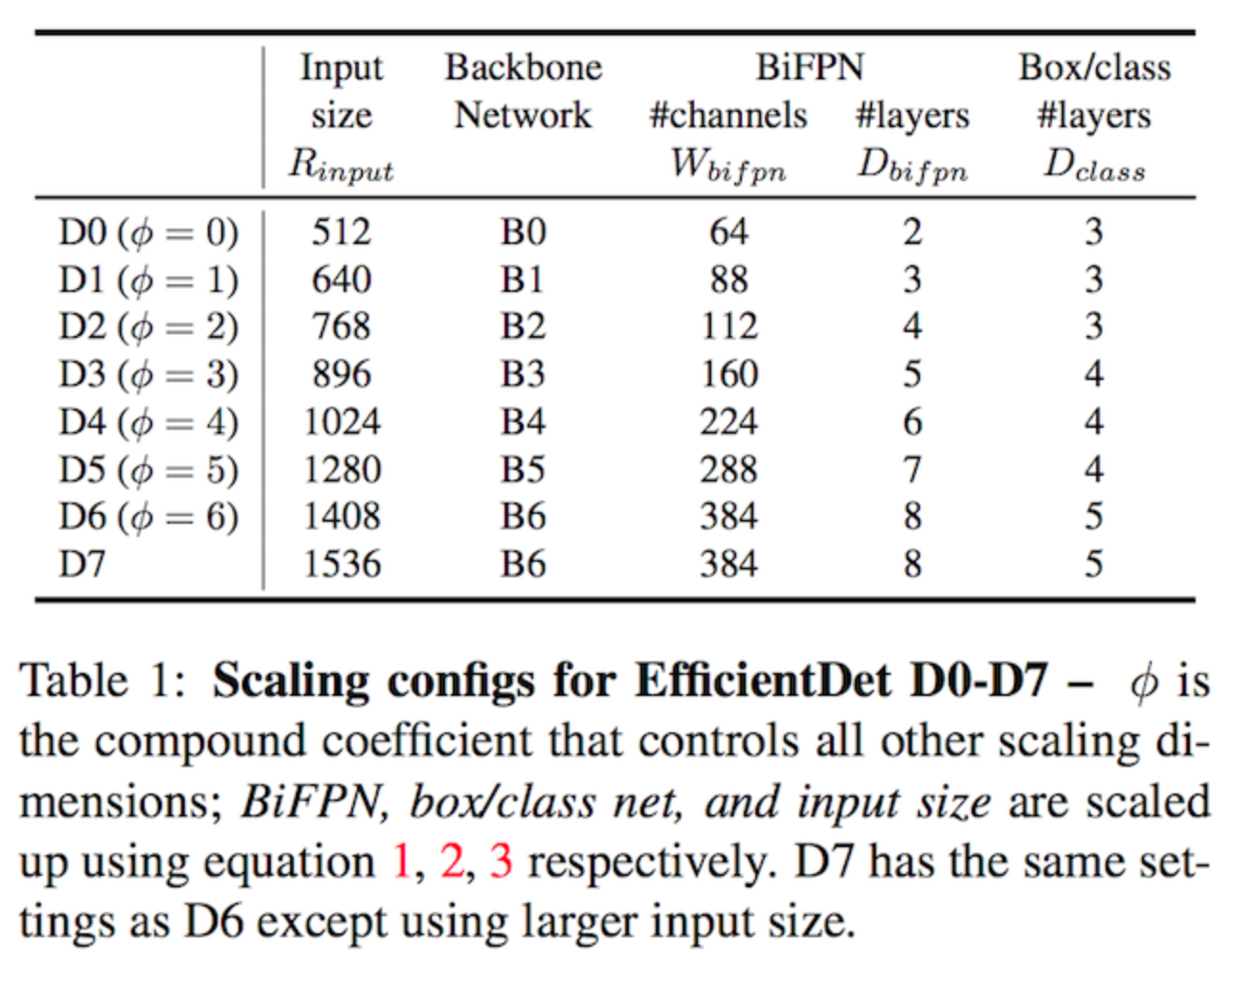
The main idea of jointly scaling up all dimensions

Slide 18
Experiments
All experiments were done on the COCO dataset.
Each model is trained using SGD optimizer with momentum 0.9 and weight decay 4e-5.
Learning rate is first linearly increased from 0 to 0.08 in the initial 5% warm-up training steps and then annealed down using cosine decay rule.
Batch Normalization is added after every convolution with batch norm decay 0.997 and epsilon 1e-4. Exponential moving average with decay 0.9998 is used.
Focal loss with α = 0.25 and γ = 1.5, and aspect ratio {1/2, 1, 2} are used.
The models are trained with batch size 128 on 32 TPUv3 chips.

Slide 19
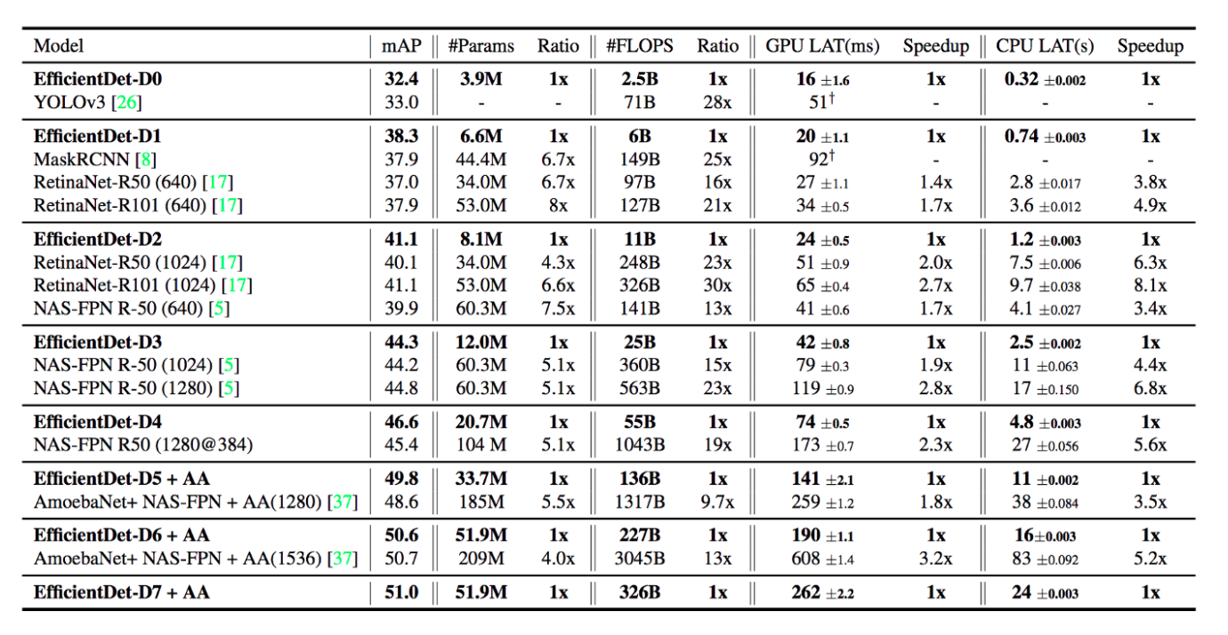
Experiments

Slide 20
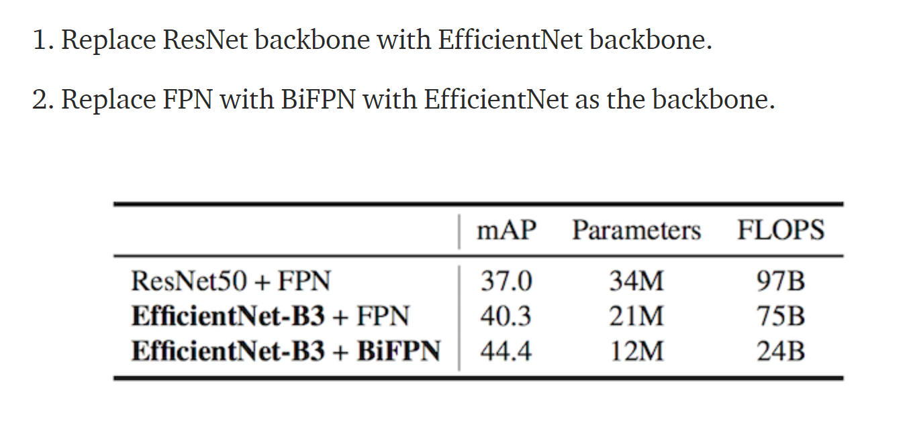
Experiments
Disentangling Backbone and BiFPN

Slide 21
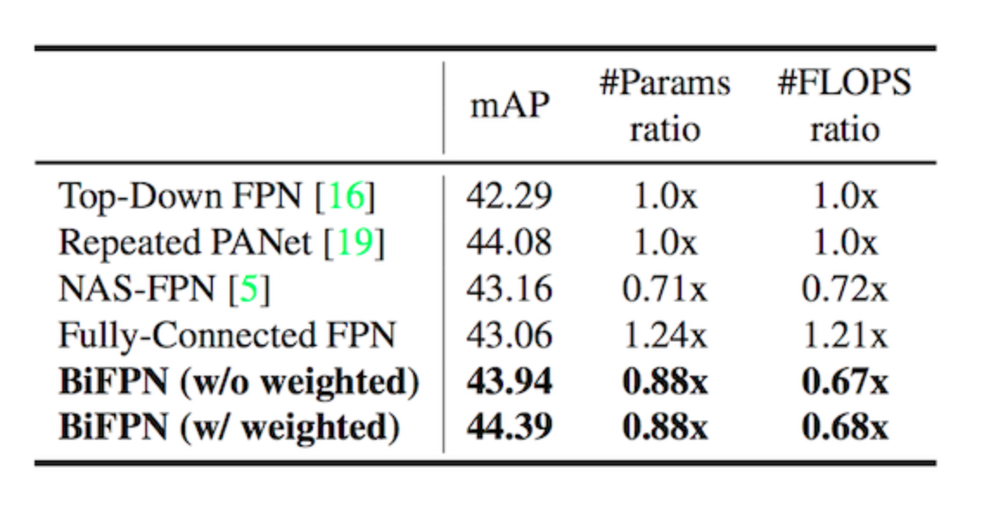
Experiments
BiFPN Cross-Scale Connections

Slide 22
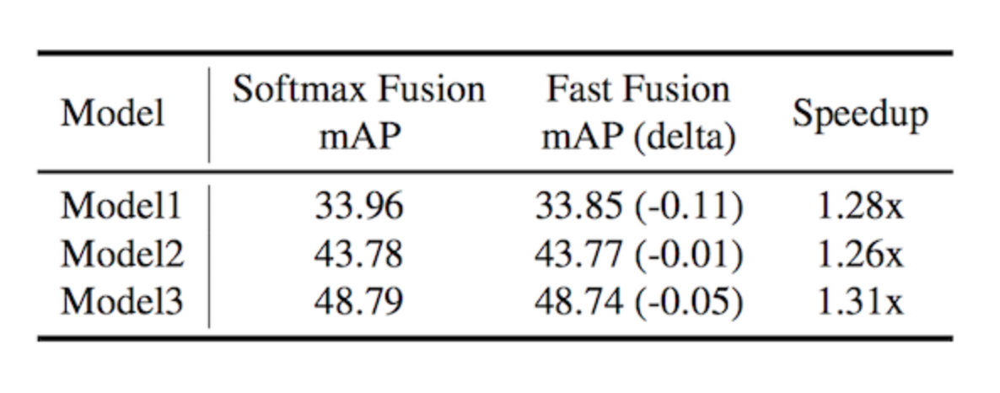
Experiments
Softmax vs Fast Normalized Fusion

Slide 23
Conclusion
We saw that FPN strategies can give huge improvements in the performance of object detection. Weighted BiFPN is just another step in finding the optimal network topology. Also, EfficientNets have officially killed ResNets! This is the era of EfficientNets and to me, it seems that they are going to stay here for a long time.

Slide 24
Thanks
Mohamed Abdo Elnashar

